Slide 1
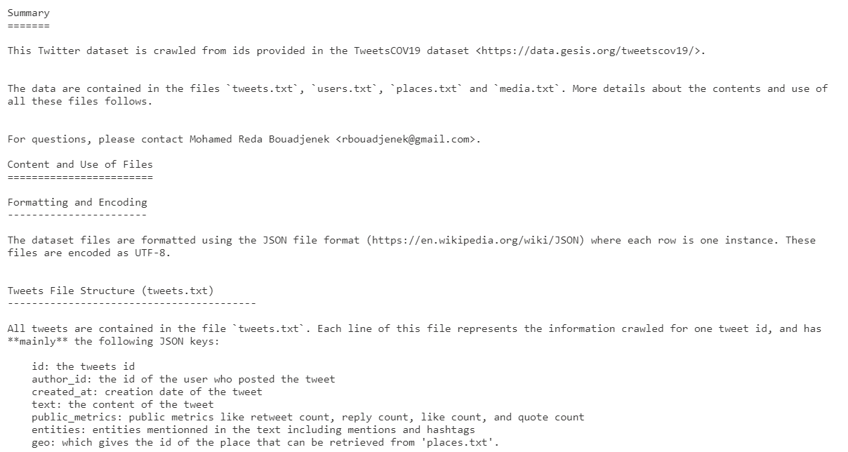
Covid19 Twitter Project
Hshmat Sahak
Litao (John) Zhou

Slide 2
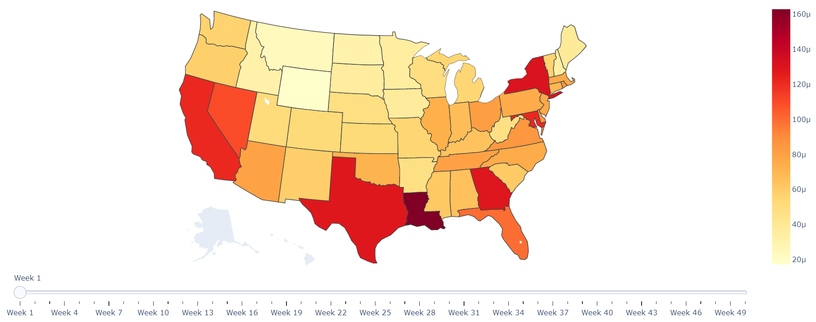
Time Series Visualizations
Weekly Twitter Count by State (Normalized by Population)

Slide 3
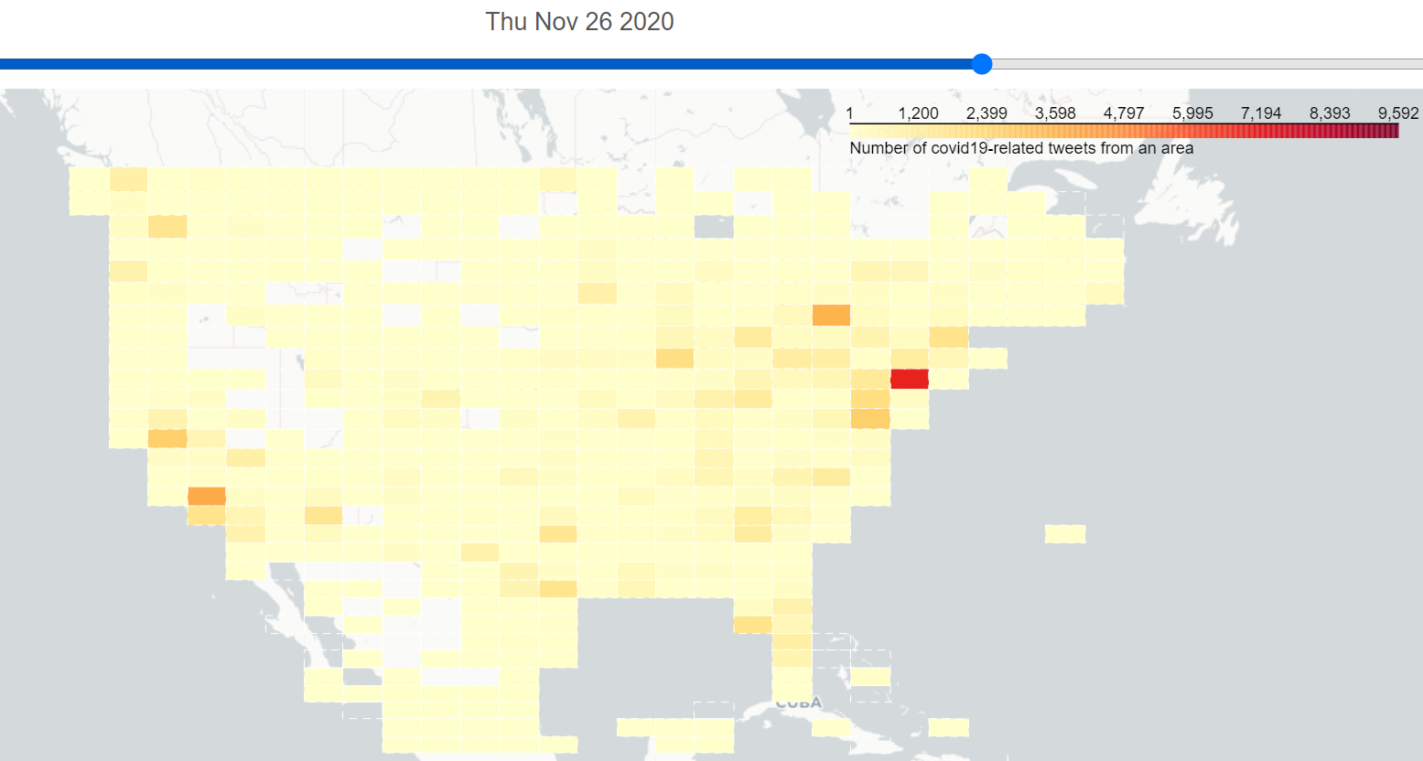
Grid Map with Time Slider
Same data as previous slide, but different visualization approach. This is grid-wise; not state-wise

Slide 4
Sentiment Analysis
Current Strategy:
Remove election-related tweets:
Trump|Biden|Election|democratic|republican|party|President|campaign|elector|candidate
Then divide into:
Family-related Tweets
sister|brother|mother|father|grandpa|grandma|grandparents|grandmother|grandfather|cousin|dad|mom
Depression-related Tweets
overwhelmed|exhausted|distressed|anxiety|anxious|tired|low|depression|discouraged|desperate|demotivated|insomnia|cry|nervous|worried|lonely|sad|empty|suicide|antidepressant|hopeless
Strict Depression-related Tweets
overwhelmed|exhausted|distressed|anxiety|anxious|depression|discouraged|demotivated|insomnia|lonely|empty|suicide|antidepressant|hopeless

Slide 5
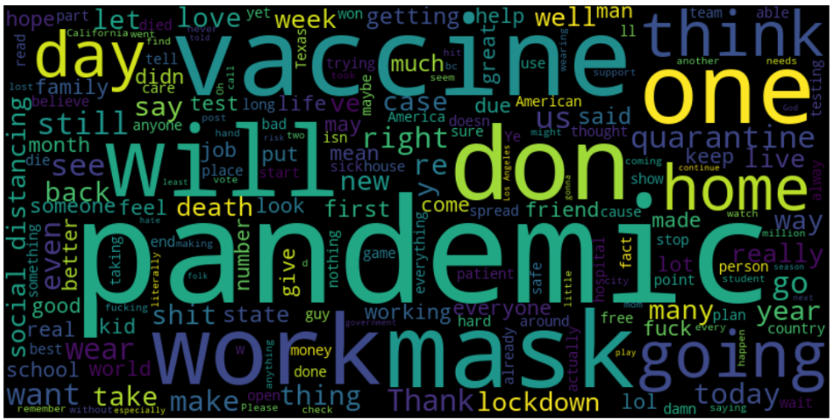
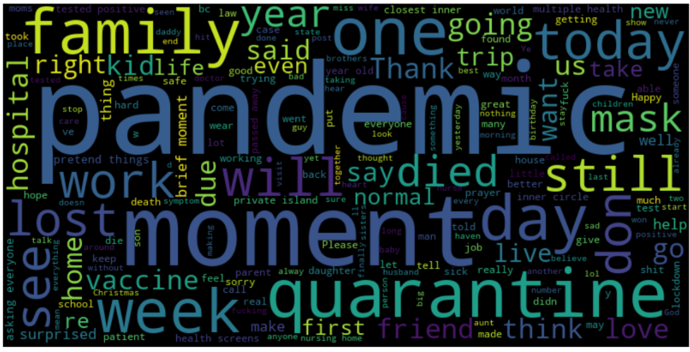
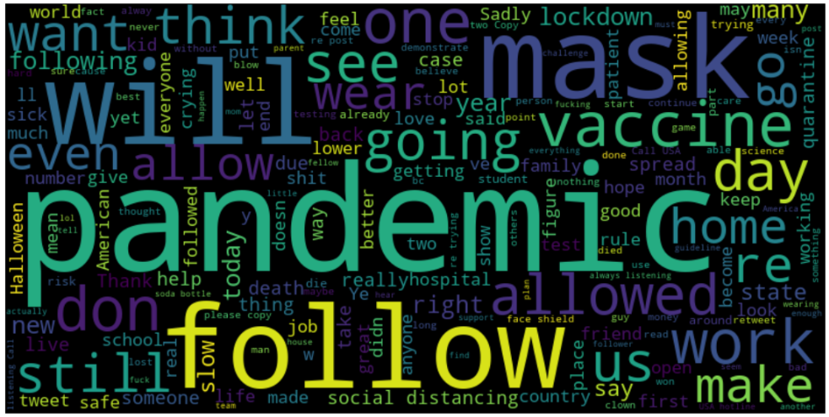
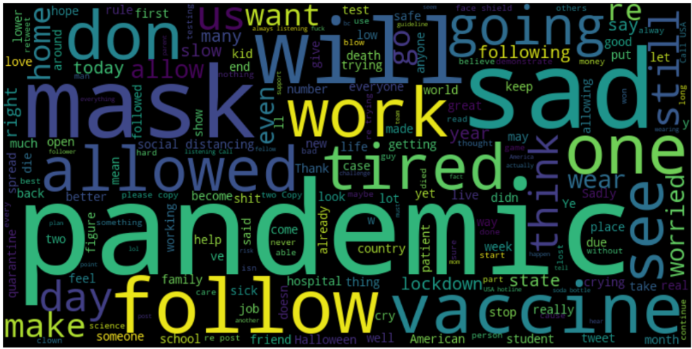
All
Family
Depresssion
Strict Depresssion

Slide 6
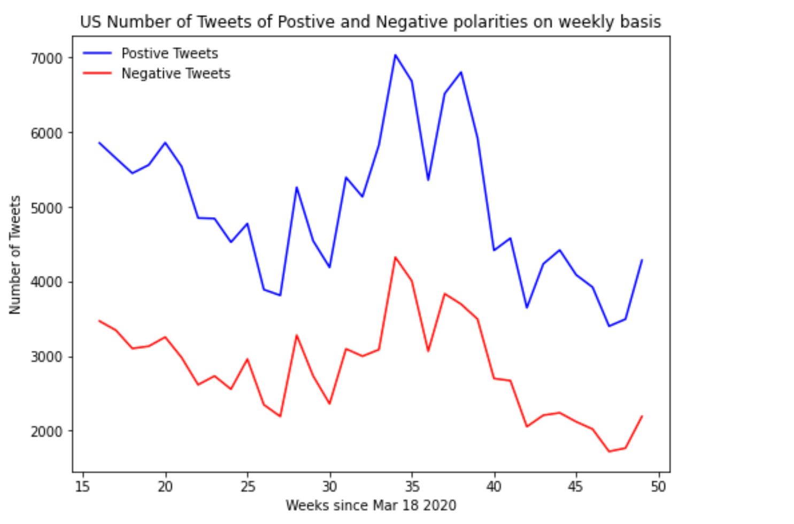

Slide 7
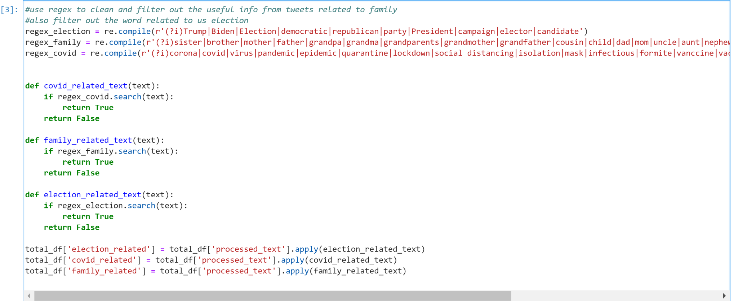
Filters for topics of family,covid and us election

Slide 8
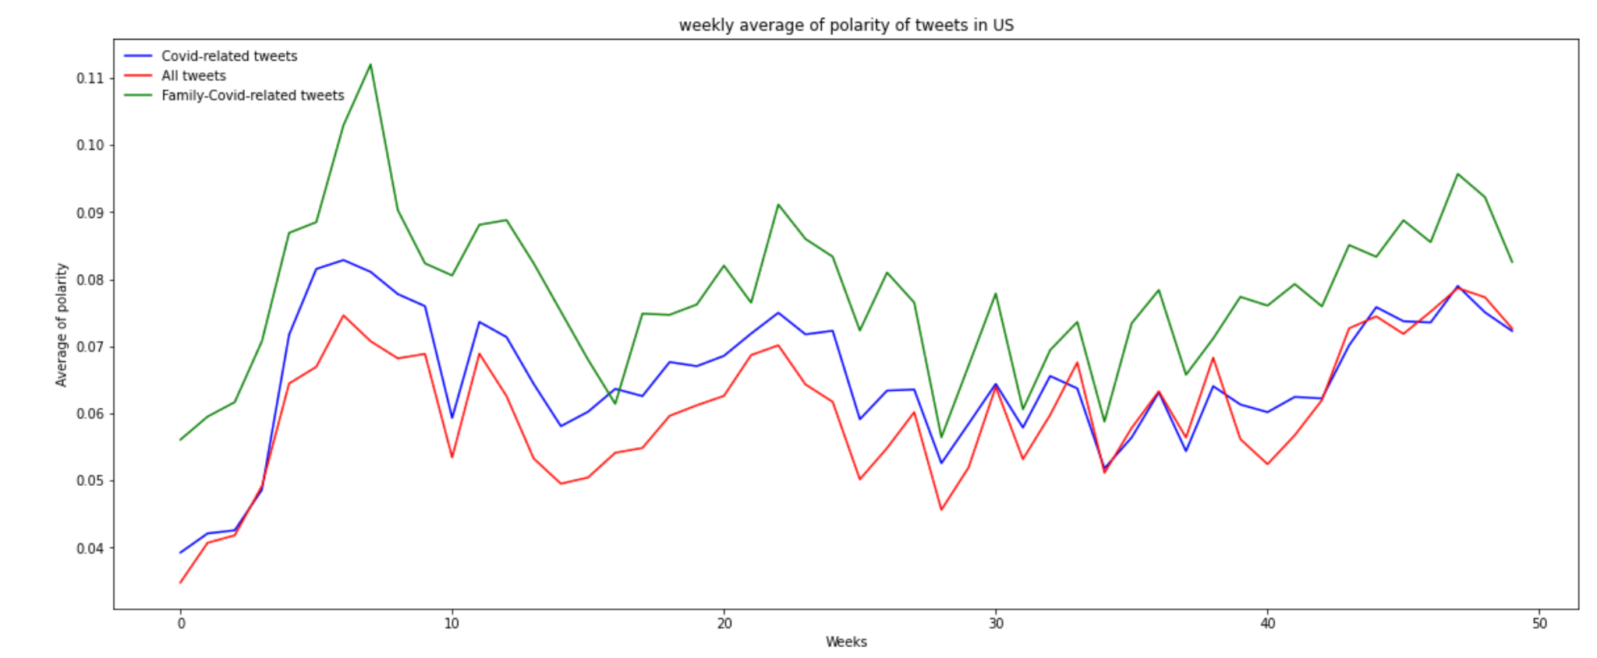

Slide 9
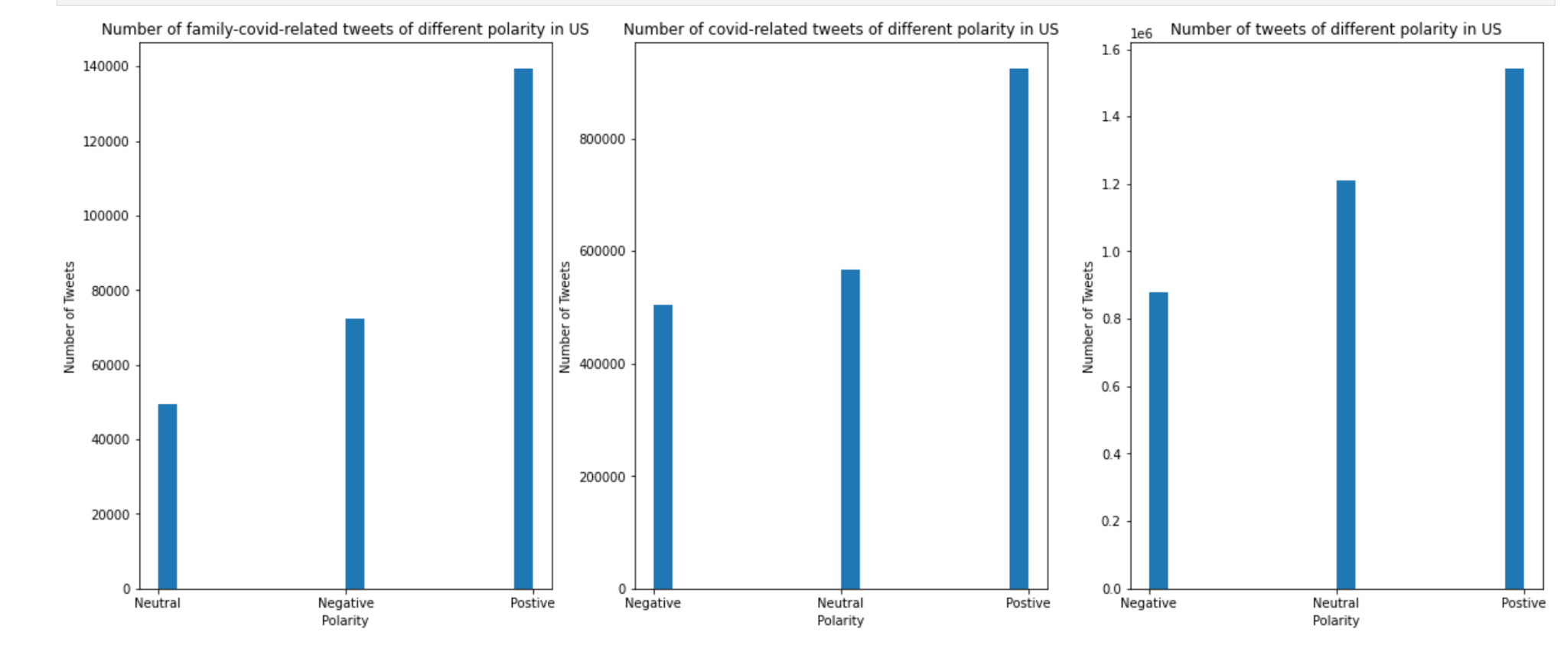
Textblob toolkit for tweets polarity analysis

Slide 10
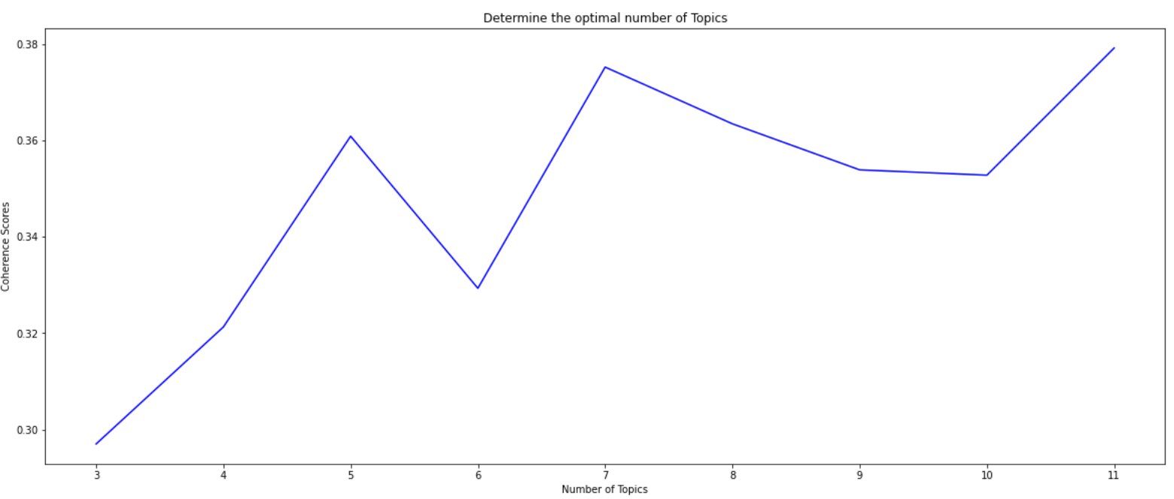
Optimal Number of Topics
Pick 7 as optimal number of topics

Slide 11
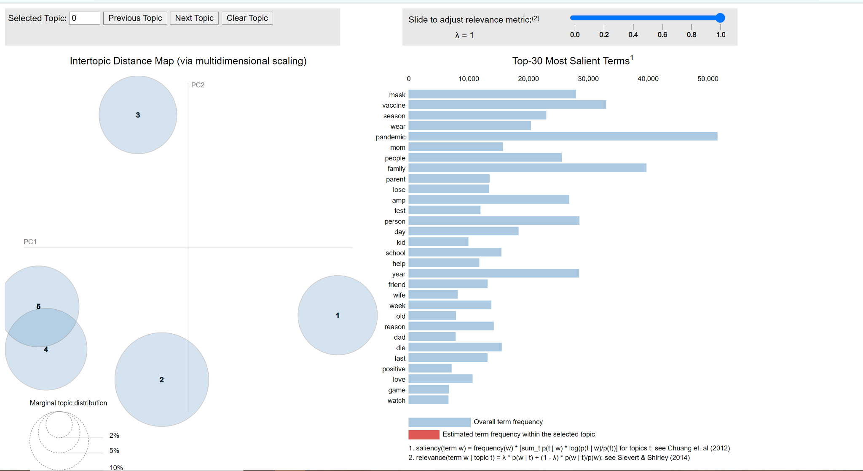
Topic Modelling - Family covid-related

Slide 12
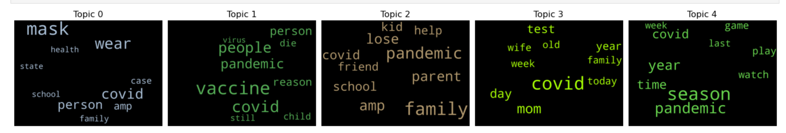
Word Cloud for Topic Modelling - Family-covid-related

Slide 13
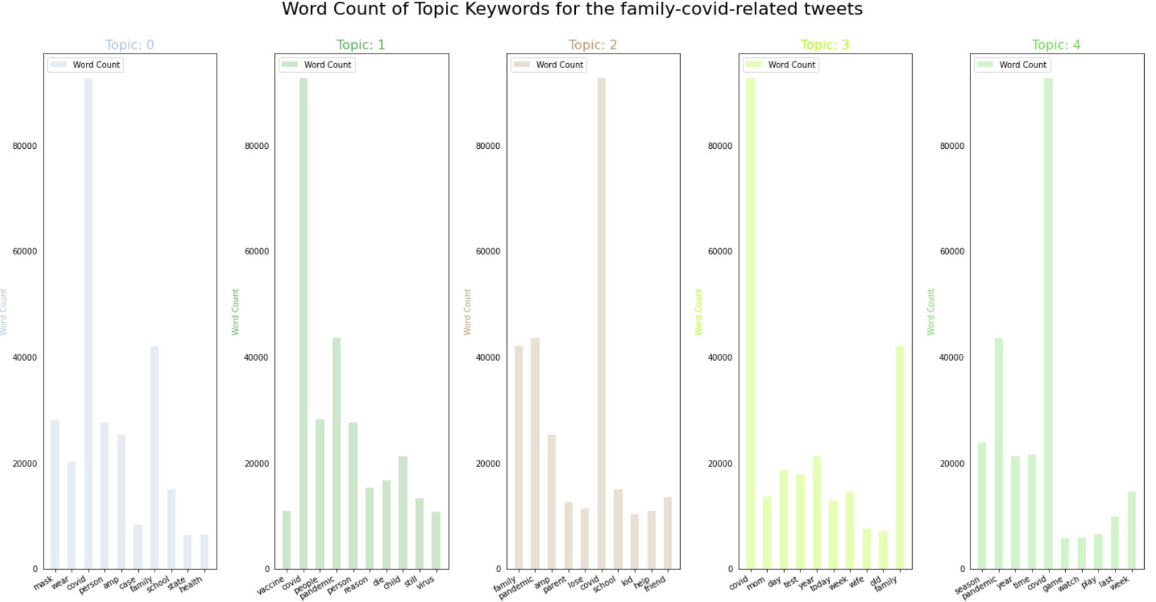

Slide 14
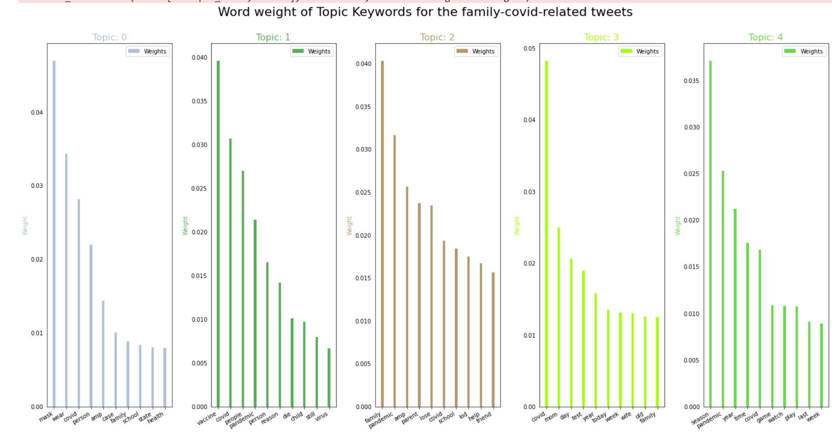

Slide 15
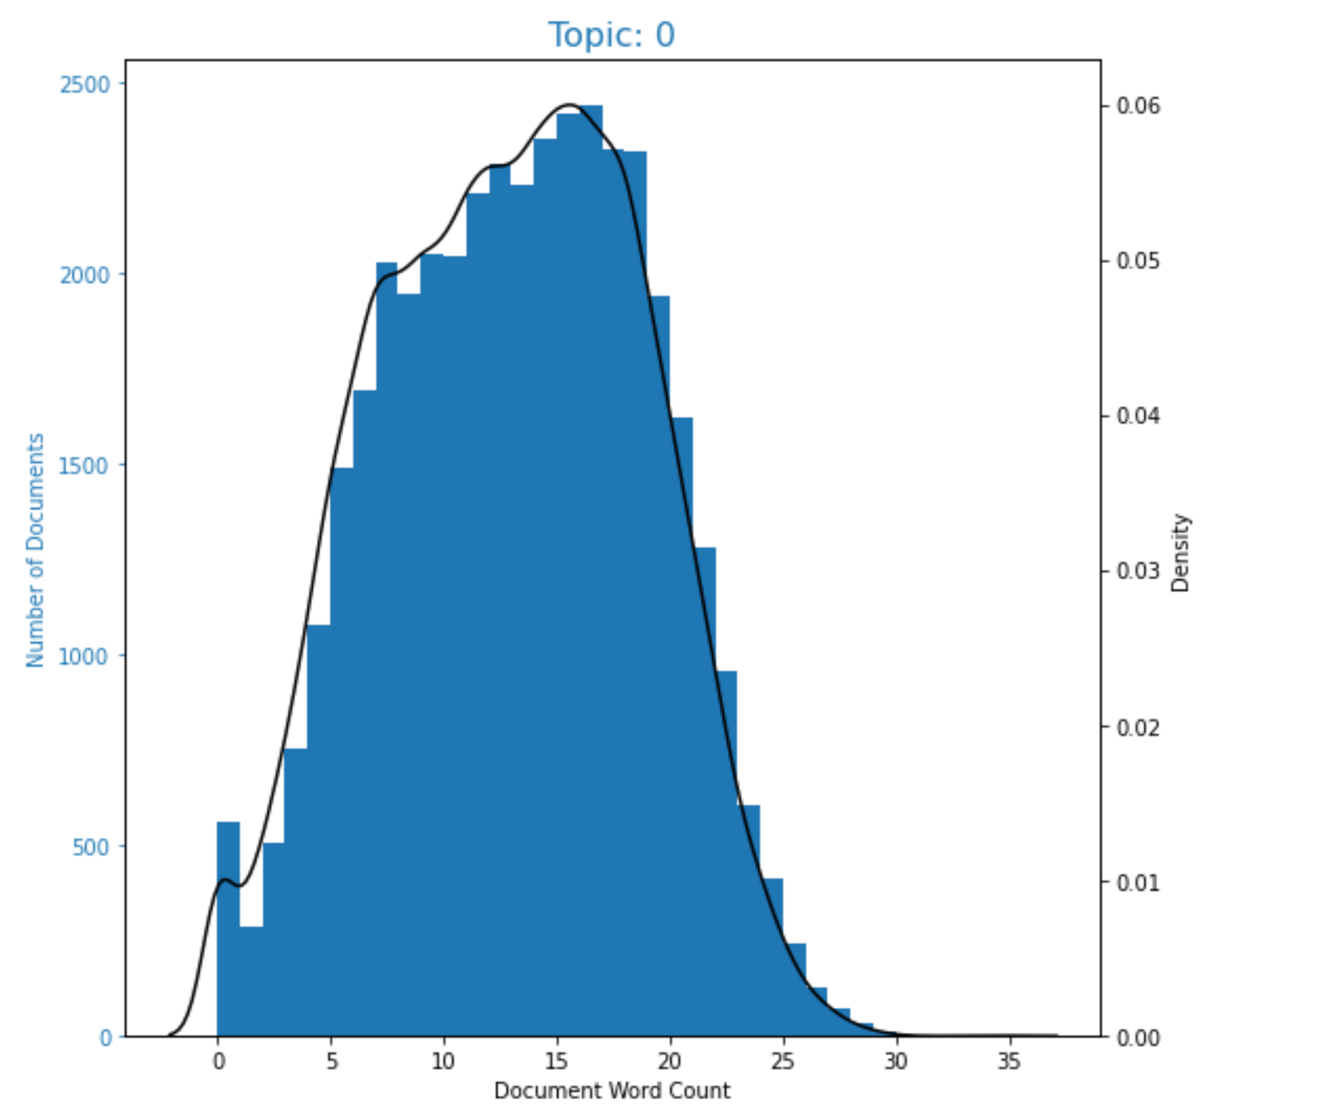
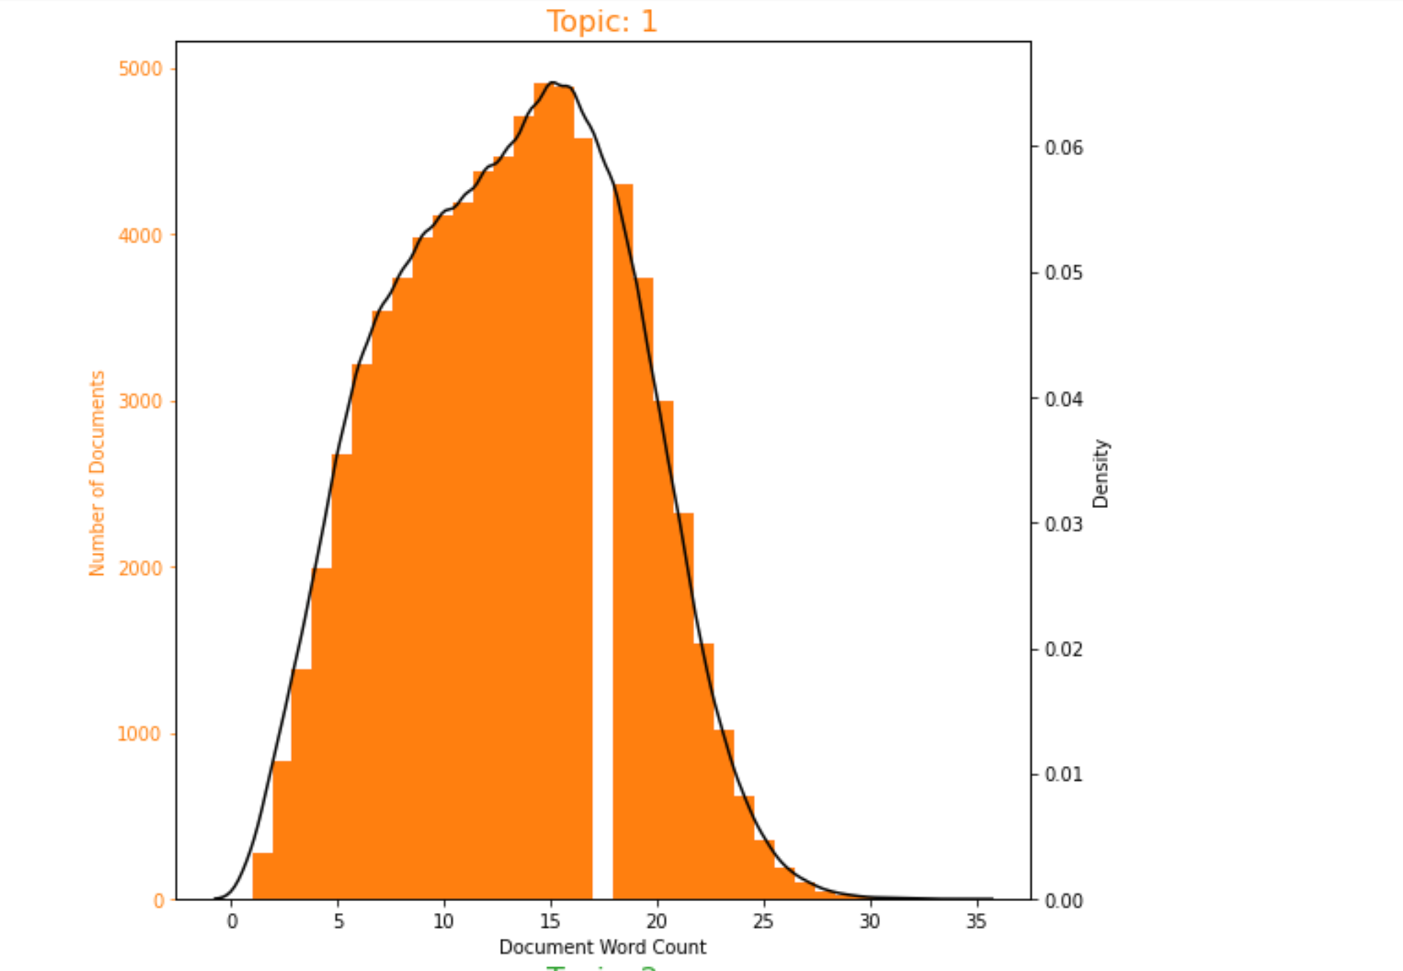
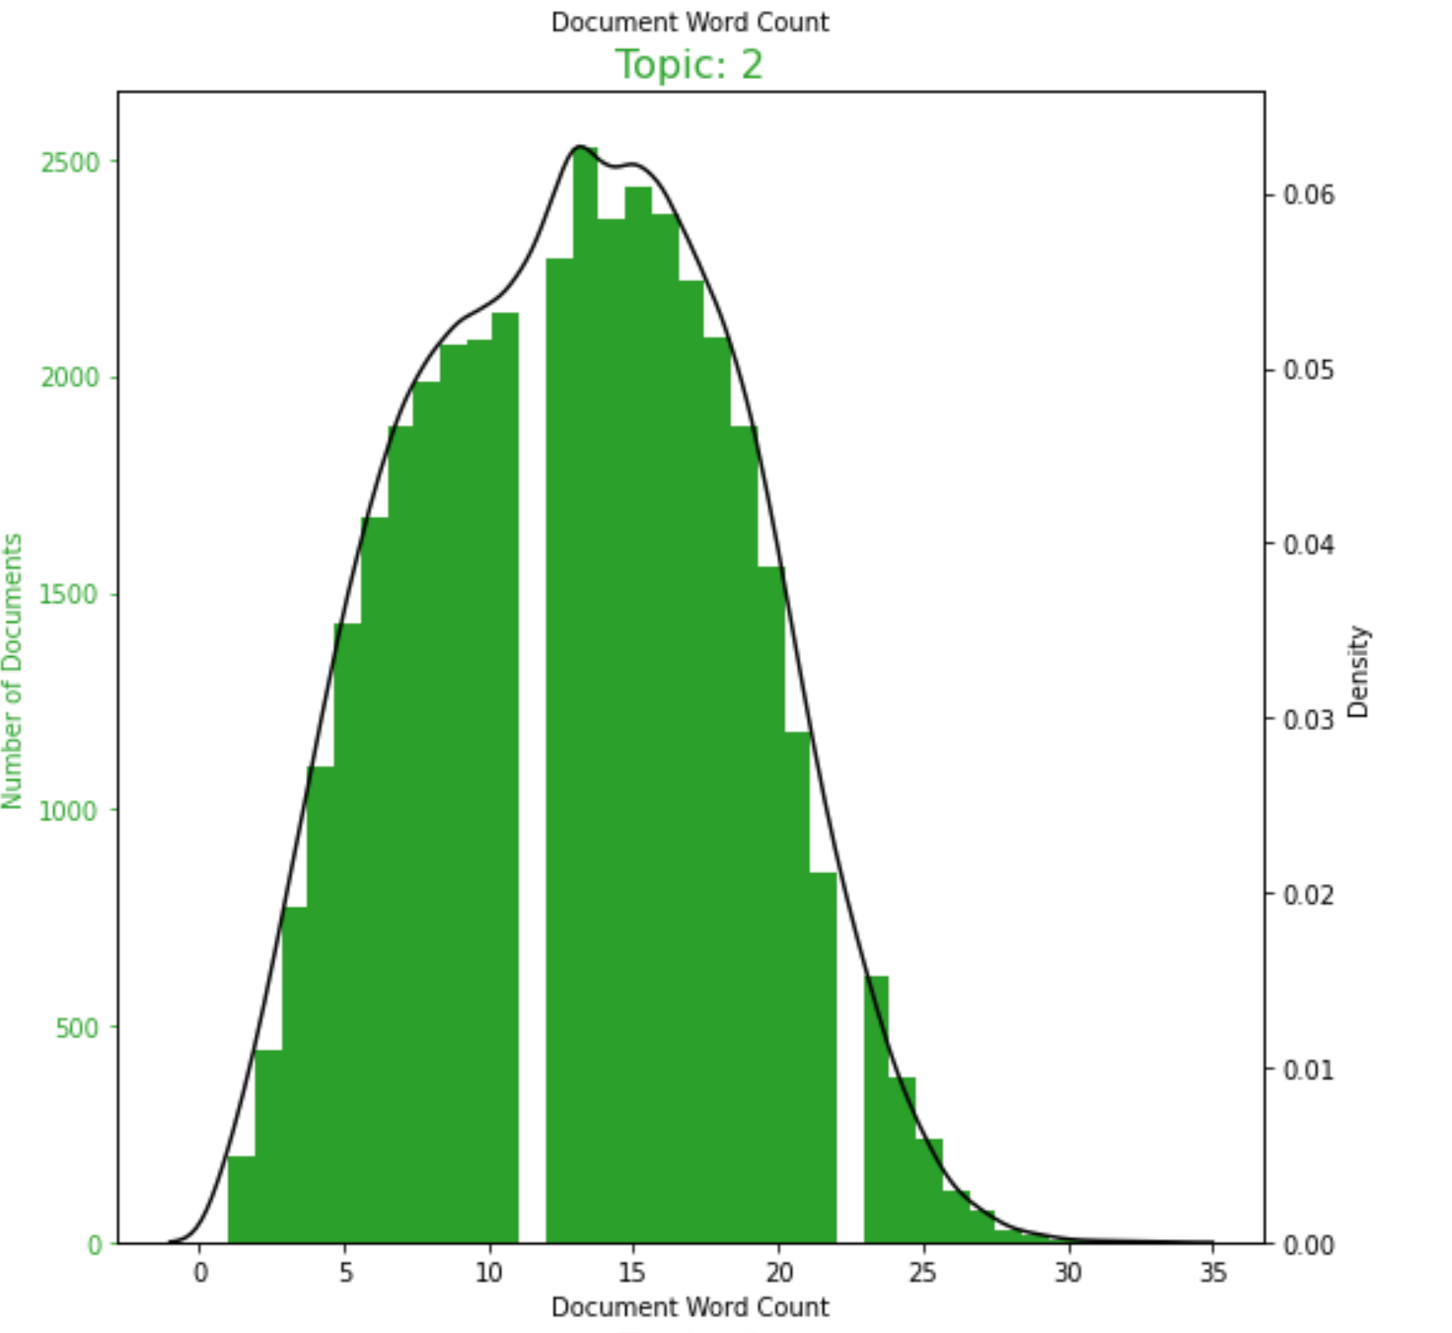
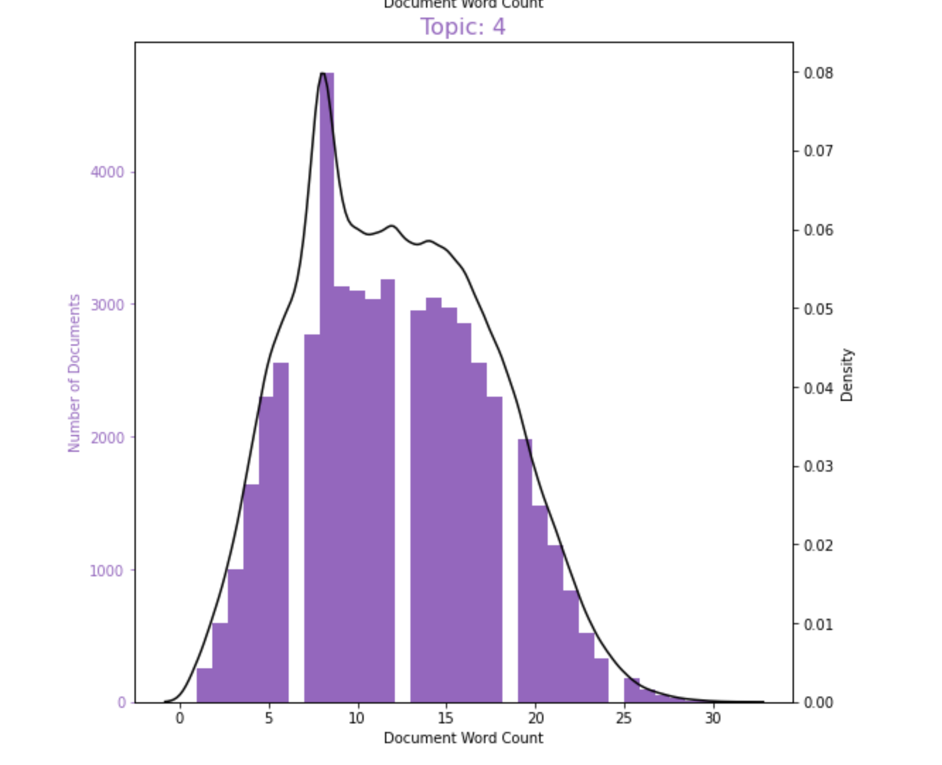
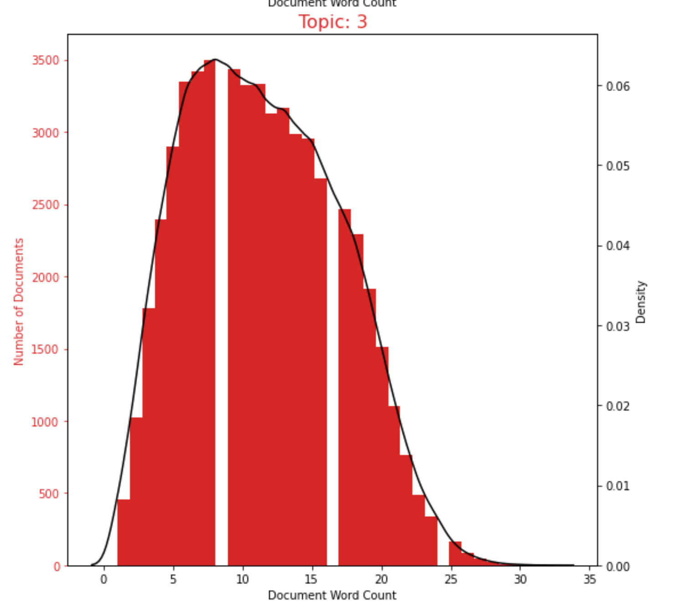
Frequency of word count in each documents

Slide 16
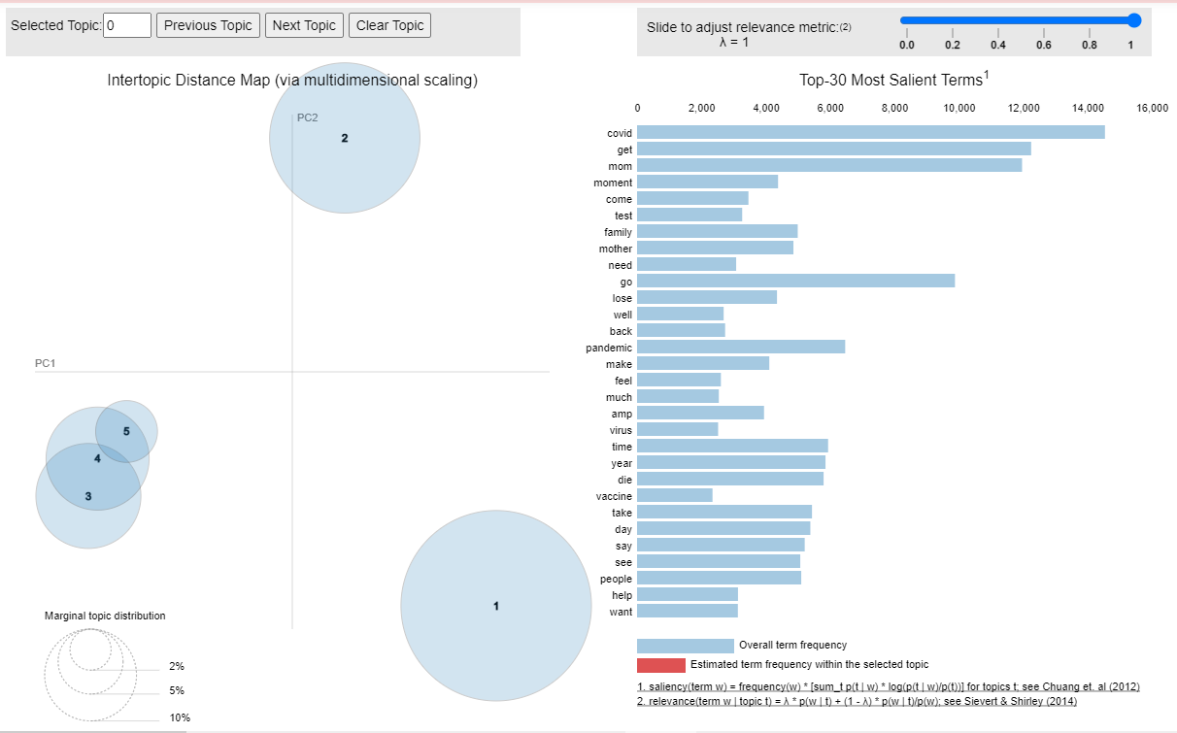
Topic Modelling- Strict Depression

Slide 17
What we need help with
What particular problem should we try to approach that hasn’t been covered by others? (or, that we can do better)
Publication is a goal here…
What better ways can we detect depression
Something better than just keywords…
Reference papers use keywords or train ML algorithms. We could get advice from a mental health expert...

